Slide 1
All About Me
By: Monique Tyler

Slide 2
Personal Facts
Born on February 24, 1995
Adopted On this date
Columbia SC
Columbia Hospital
No Siblings
None that I know of

Slide 3
I used to as a kid..
Change into a lot of clothes
Stop in the middle of what I’m doing and freeze
Get Lost

Slide 4
Spare Time To Do’s
Sing
When I’m bored
Dance
Not professionally
Work
@ McDonald’s

Slide 5
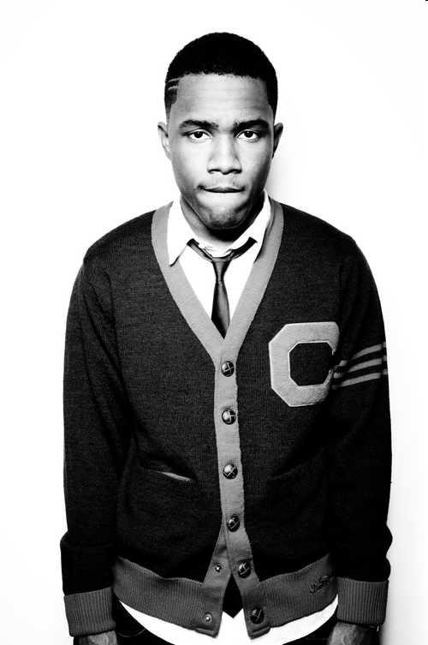
Type of Music
Soul
Lauryn Hill
Erykah Badu
Rap
Tupac & Bigly
R&B
Frank Ocean & Maxwell

Slide 6
Being Tall
I don’t like
To much Attention
“I remember when you were…”
“Your So Tall… You should be a model”

Slide 7
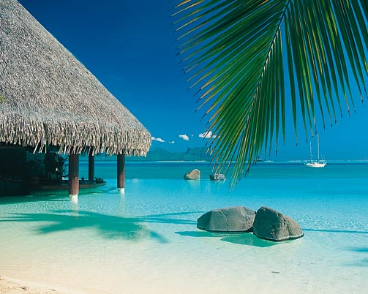
Fantasy Vacation
Jamaica
Tahiti
Europe

Slide 8
Colors I like that Mean something
Purple:
Stands for Royalty and Loyalty
Teal
The color of Ovarian Cancer

Slide 9
My Funniest Memories
Seeing My God sister going down a water slide. when she came up her top was missing.
Seeing My baby cousin make he Famous Face
Trying to catch a squirrel in my house.

Slide 10
Boring Moments
After cleaning up
No Cable or / internet
Not Having my car

Slide 11
I Hate . . .
When people know something about you and they say nothing
Being in a place where I hardly know anyone
Feet

Slide 12
I love . .
My Mom <3
Being a teenager
Making people laugh

Slide 13
Favorite Movie
Transformers
Favorite Characters
Bumble Be and Optimist Prime

Slide 14
I like wearing
Patterns
Bright Colors
Jean Material

Slide 15
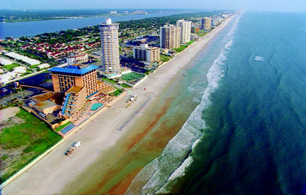
Best Vacations
Going to Indiana to see My mom’s friend
Going to Tennessee with My god brother
Going to Daytona Beach with Just my mom

