Slide 1
Protect your Good Name
Reduce Your Risk of Identity Theft

Slide 2
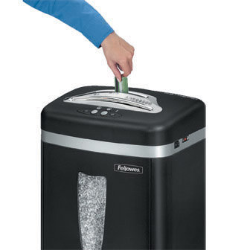
Reduce To Personal Data
Shred credit card offers
Use a locked mailbox
Mail envelopes inside the post office
Remove listing from telephone directory

Slide 3
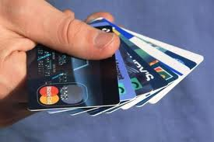
Internet and Security Safeguard
Install a firewall
Install and update virus protection software
Never respond to phishing e-mail
Use credit, not debit cars when shopping

Slide 4
Beware of ‘Shoulder Surfers
Shield your hand when entering your PIN. Thieves may be watching with binoculars

