Slide 1
Tree Pests
Creature That Bug Our Trees
Jim De Young
Botany 202

Slide 2
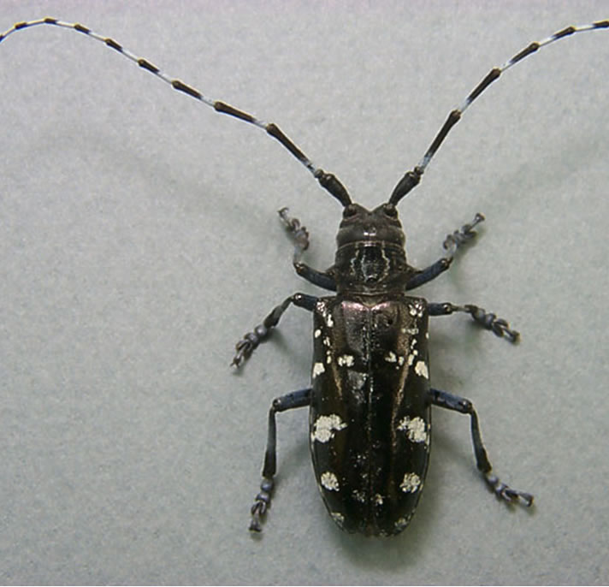
A Longhorn Beetle
Native to China
Transport to United States In Infested United packing material

Slide 3
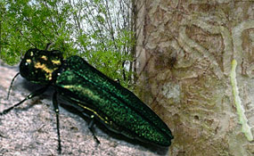
Emerald Ash Borer
Killed 20 million trees in Michigan, Ohio, and Indiana
Firewood quarantines to prevent new infestation

Slide 4
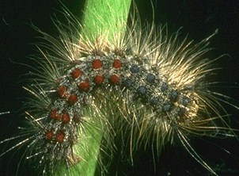
Gypsy Moth
Spread to U.S. in 1870
Oaks and Aspens are most common hosts
Larva defoliate trees
Small mammals and birds are predators

